Slide 1
数字信号处理第二章习题课

Slide 2
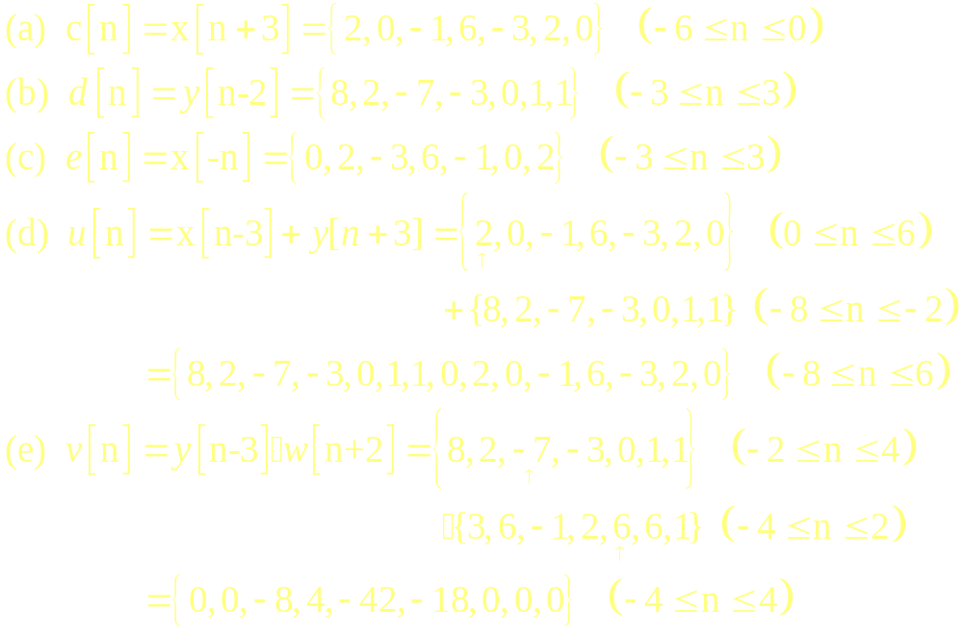
2.3 Solution

Slide 3
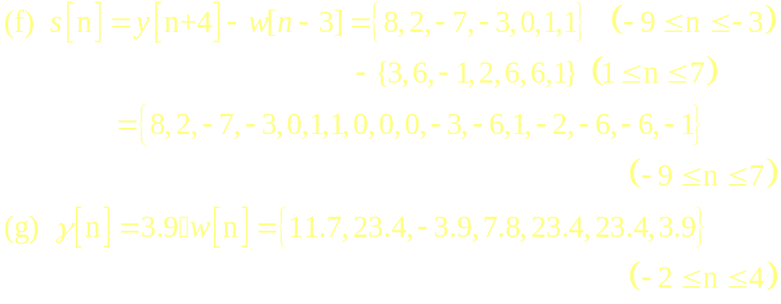
2.3 Solution

Slide 4
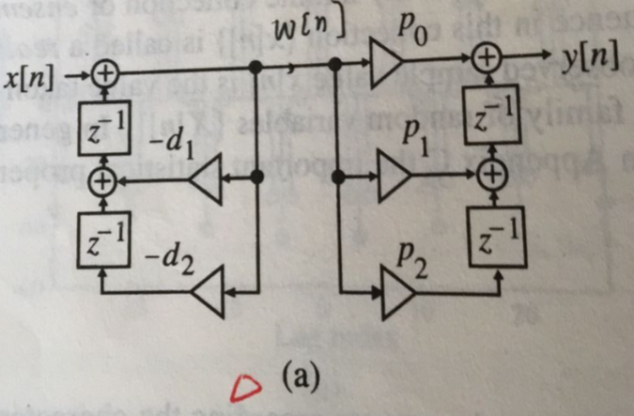
2.4 Solution
(a)

Slide 5
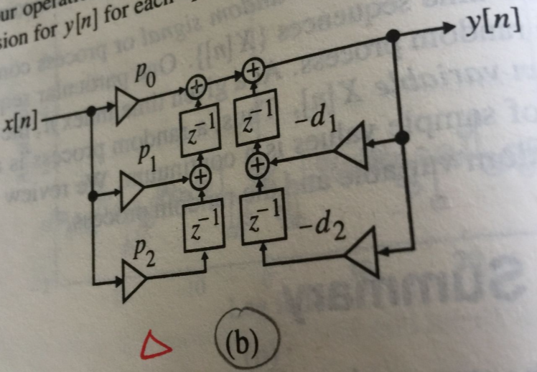
2.4 Solution
(b)

Slide 6
2.5 Solution

Slide 7
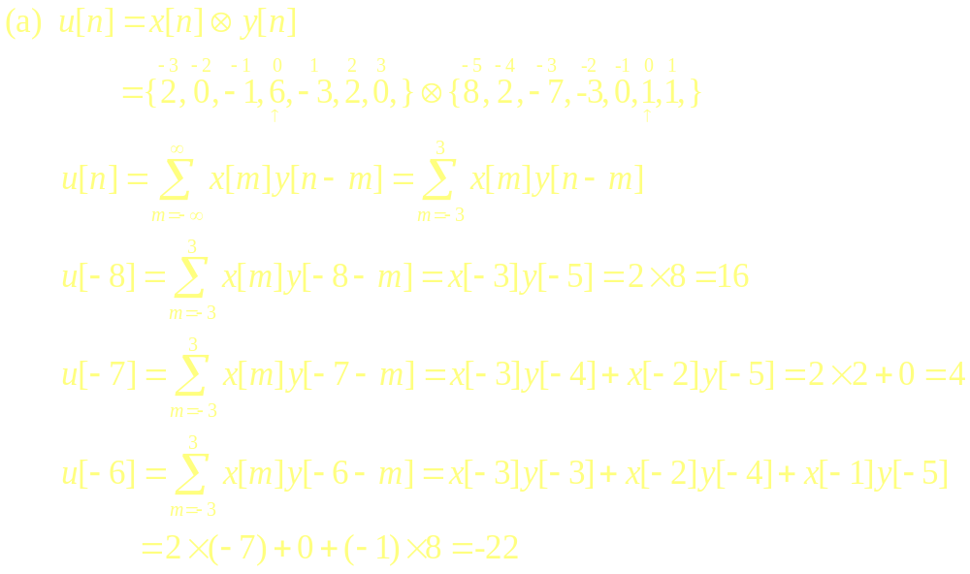
2.9 Solution

Slide 8
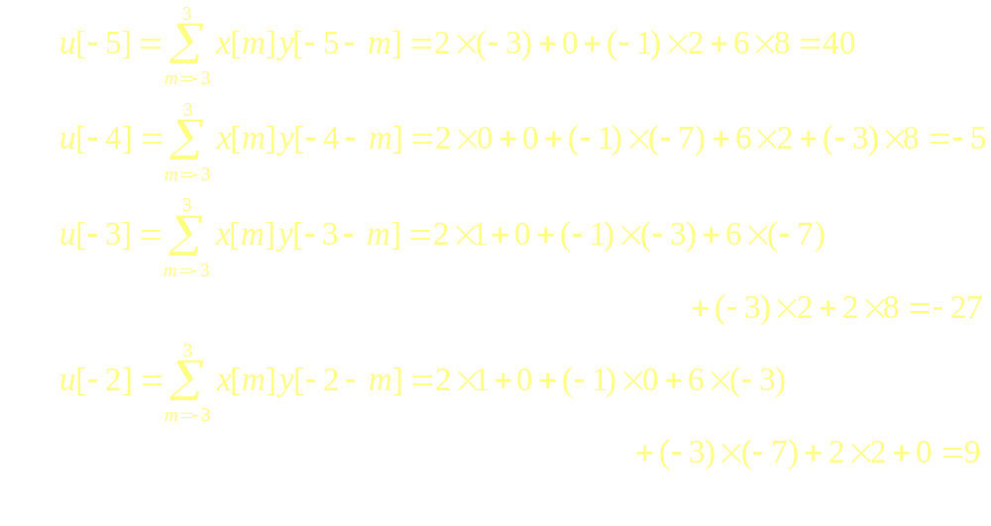
2.9 Solution

Slide 9
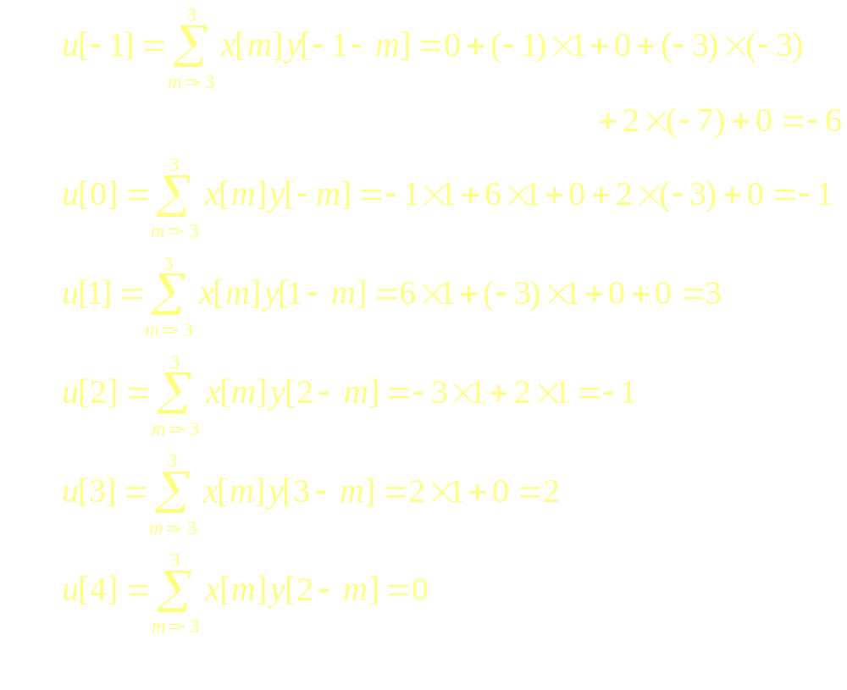
2.9 Solution

Slide 10
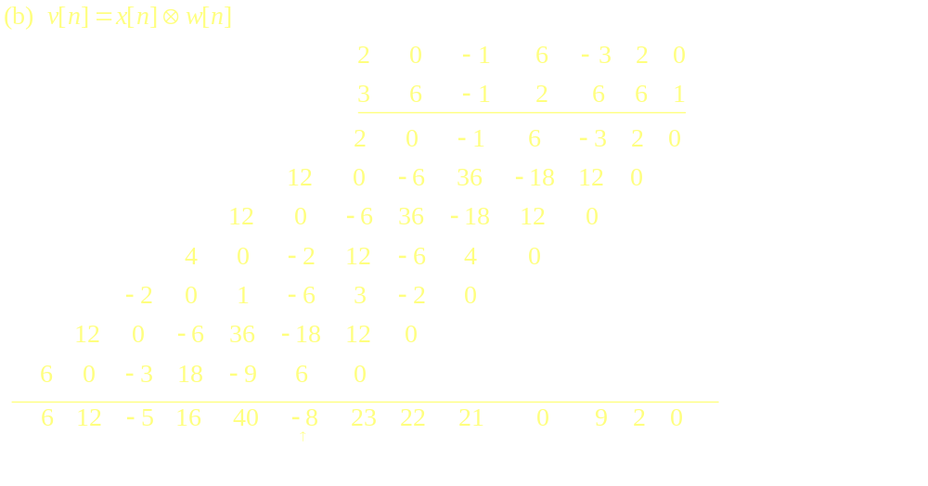
2.9 Solution

Slide 11
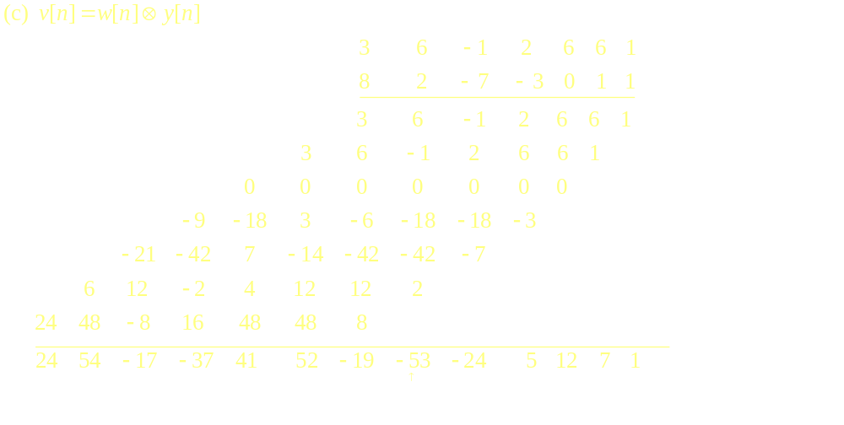
2.9 Solution

Slide 12
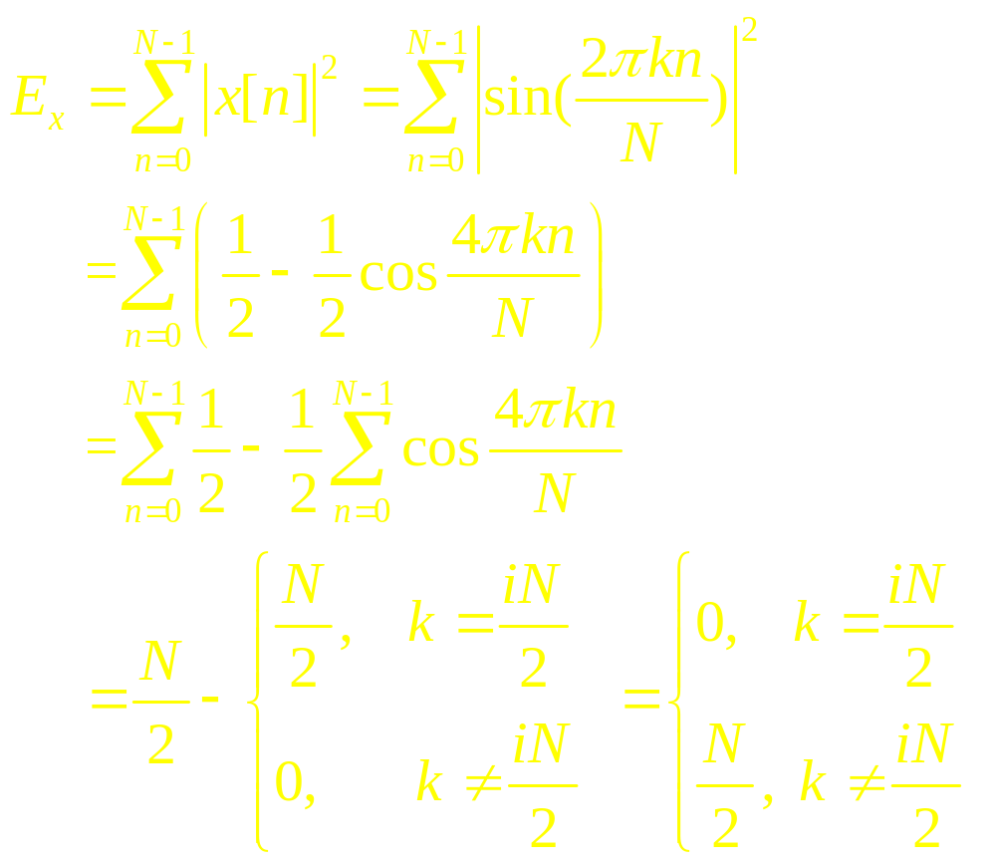
2.19 Solution

Slide 13
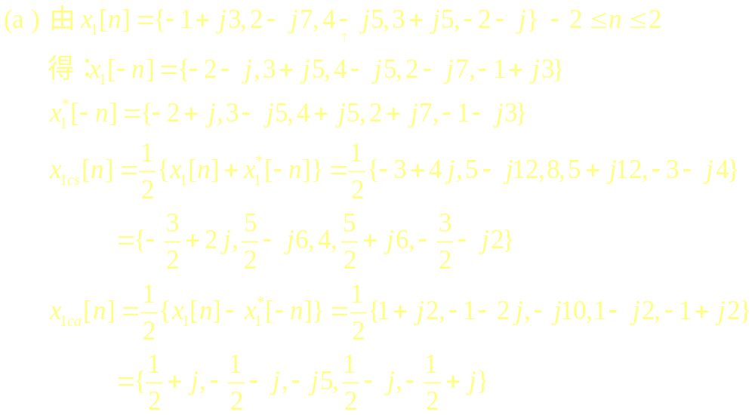
2.21 Solution

Slide 14
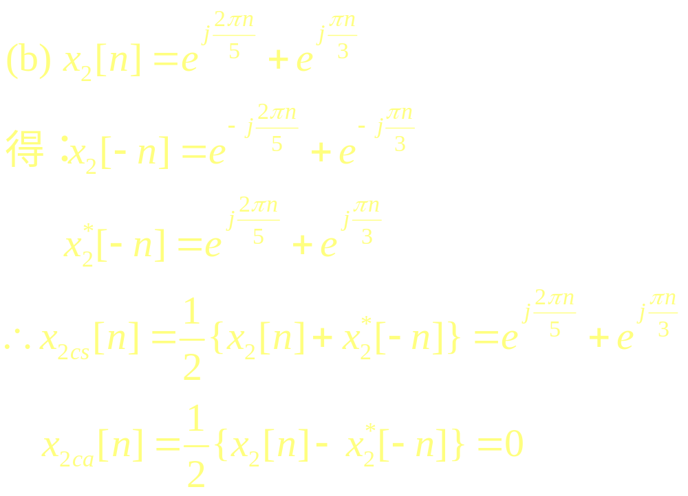
2.21 Solution

Slide 15
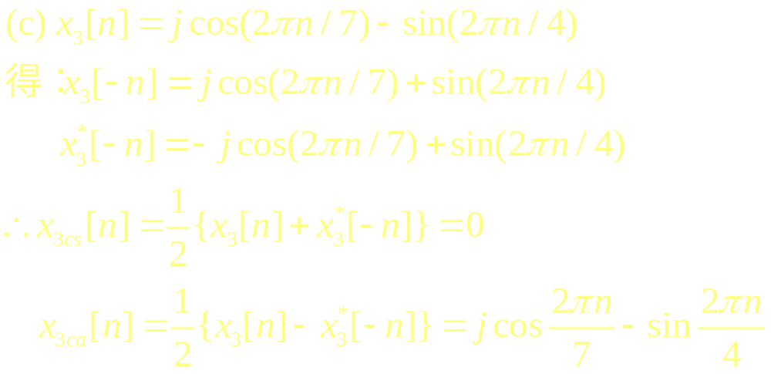
2.21 Solution

Slide 16
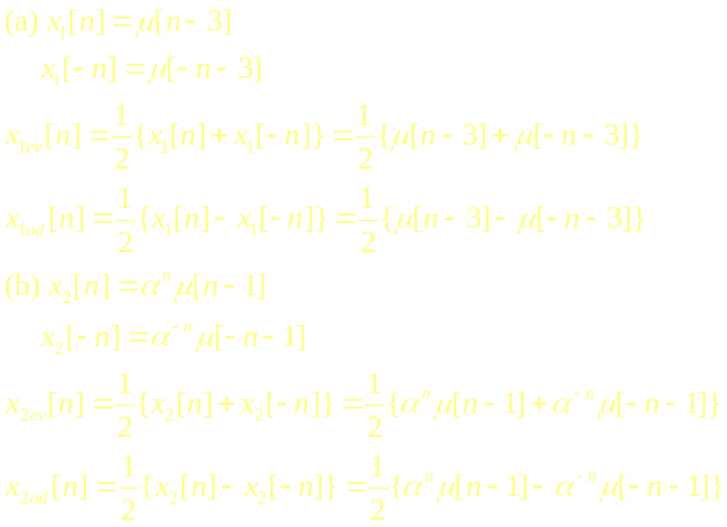
2.27 Solution

Slide 17
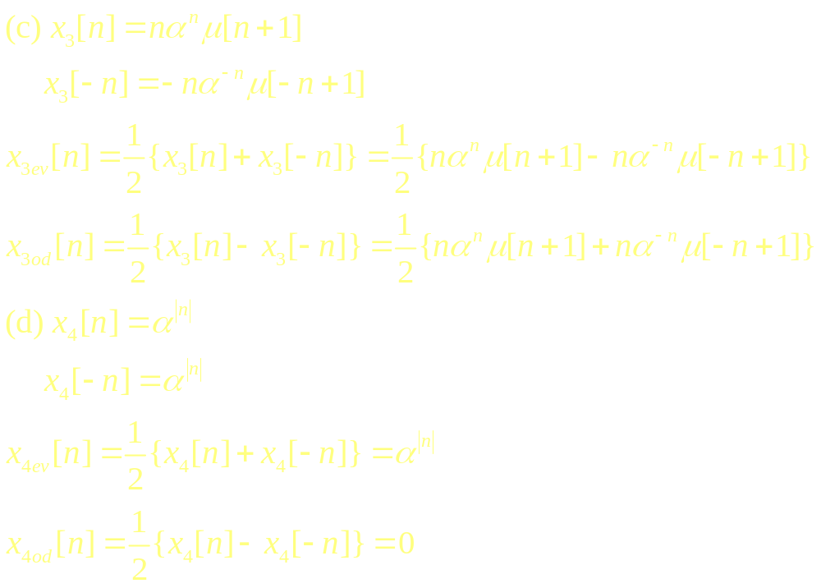
2.27 Solution

Slide 18
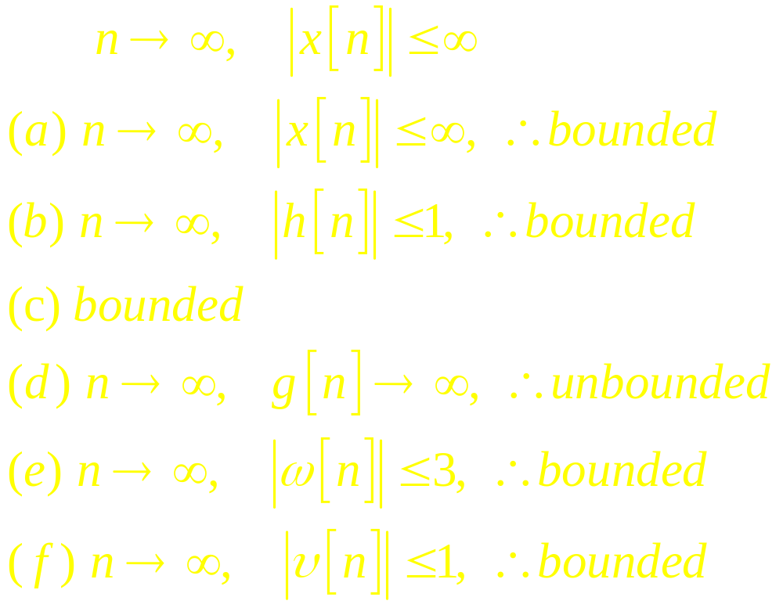
2.28 Solution

Slide 19
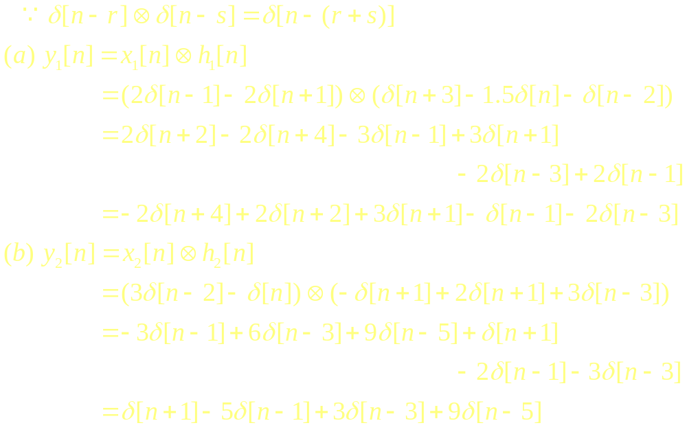
2.47 Solution

Slide 20
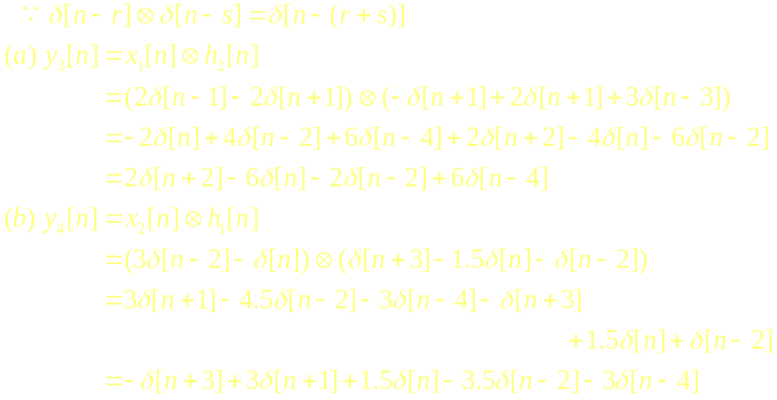
2.47 Solution

Slide 21
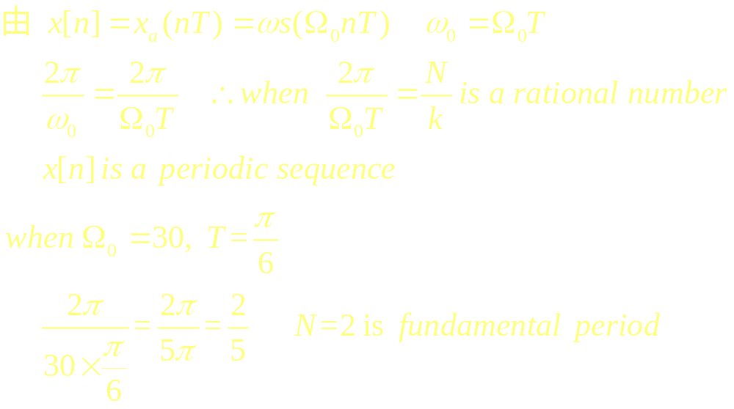
2.51 Solution

